Slide 1


Slide 2

OF THE PEOPLE,BY THE PEOPLE
GOVERNMENT AND ITS FUNCTIONS
THE CONSTITUTION
FUNDAMENTAL RIGHts AND DUTIES

Slide 3
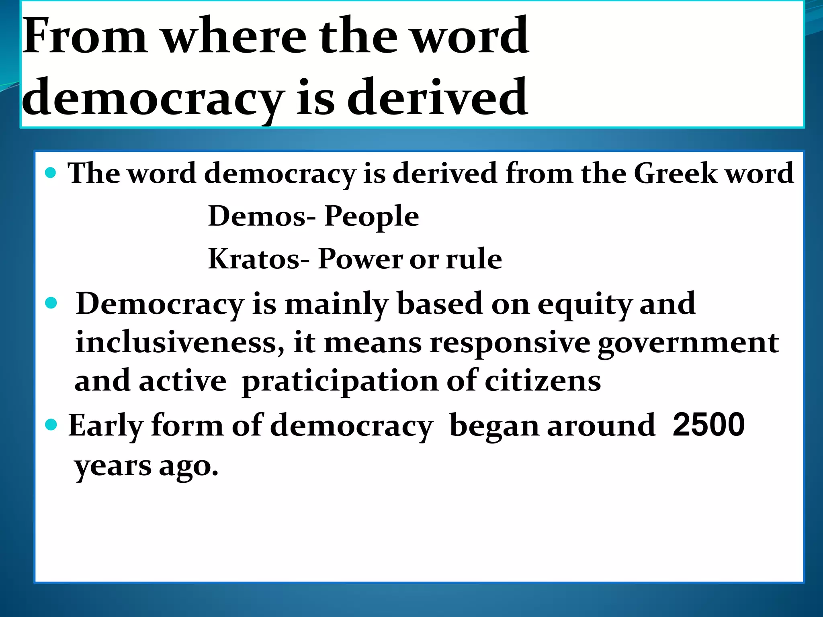
DEMOCRACY MEANING

Slide 4
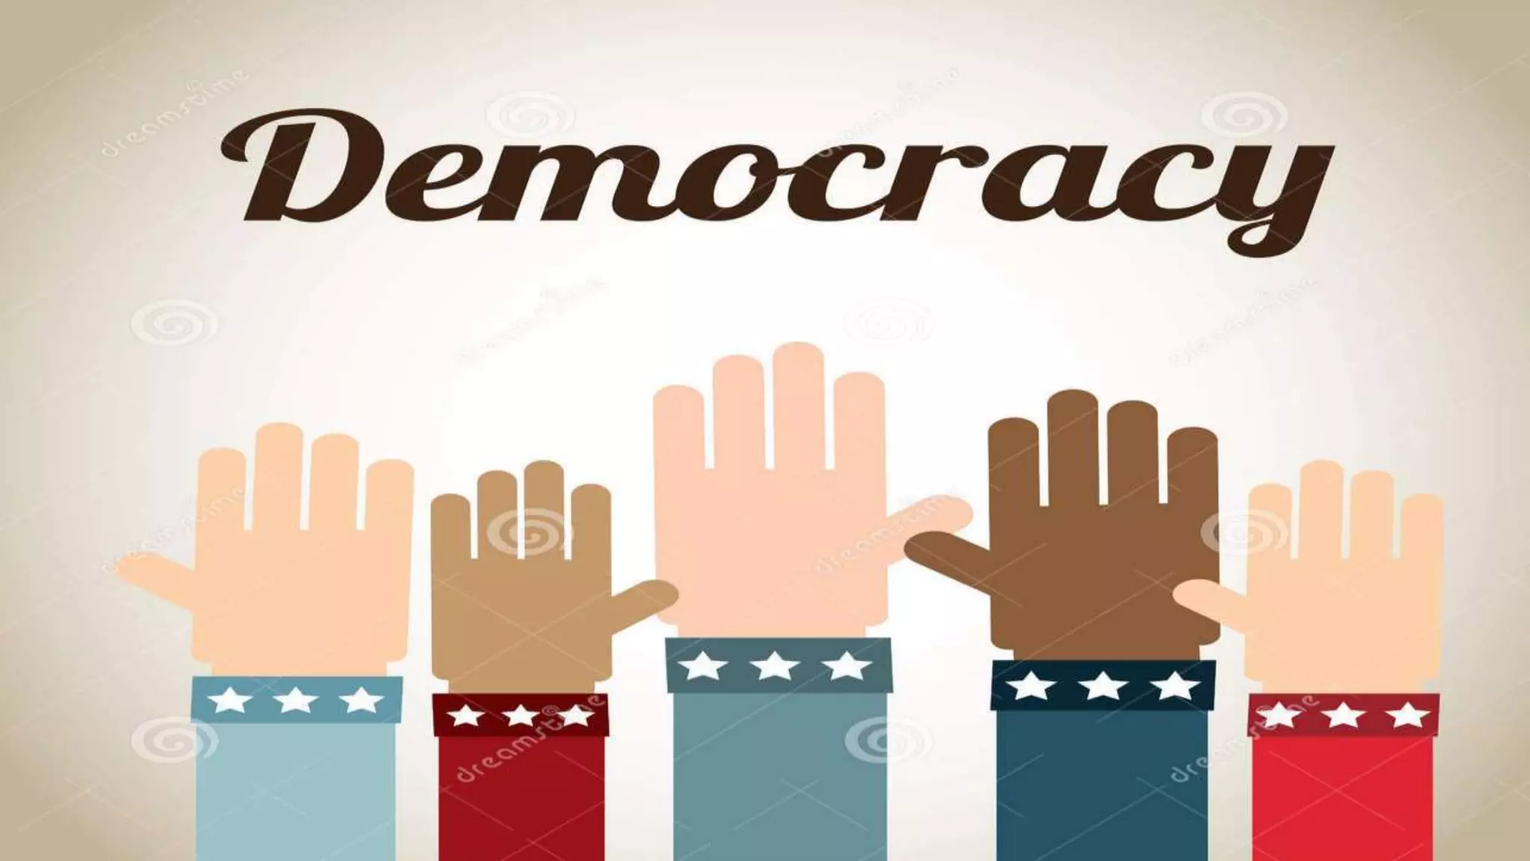
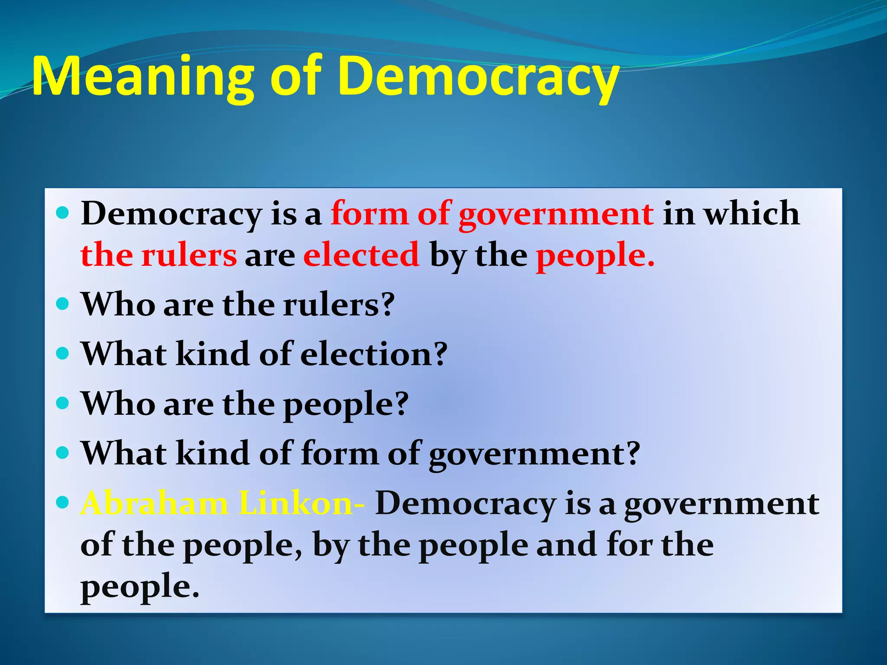
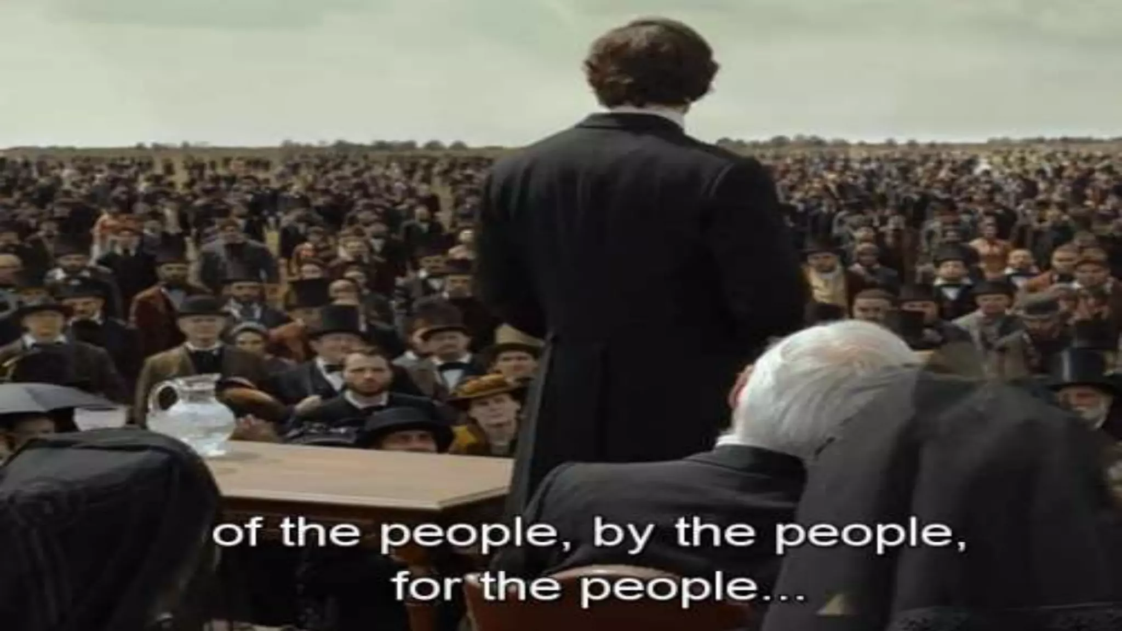

Slide 5
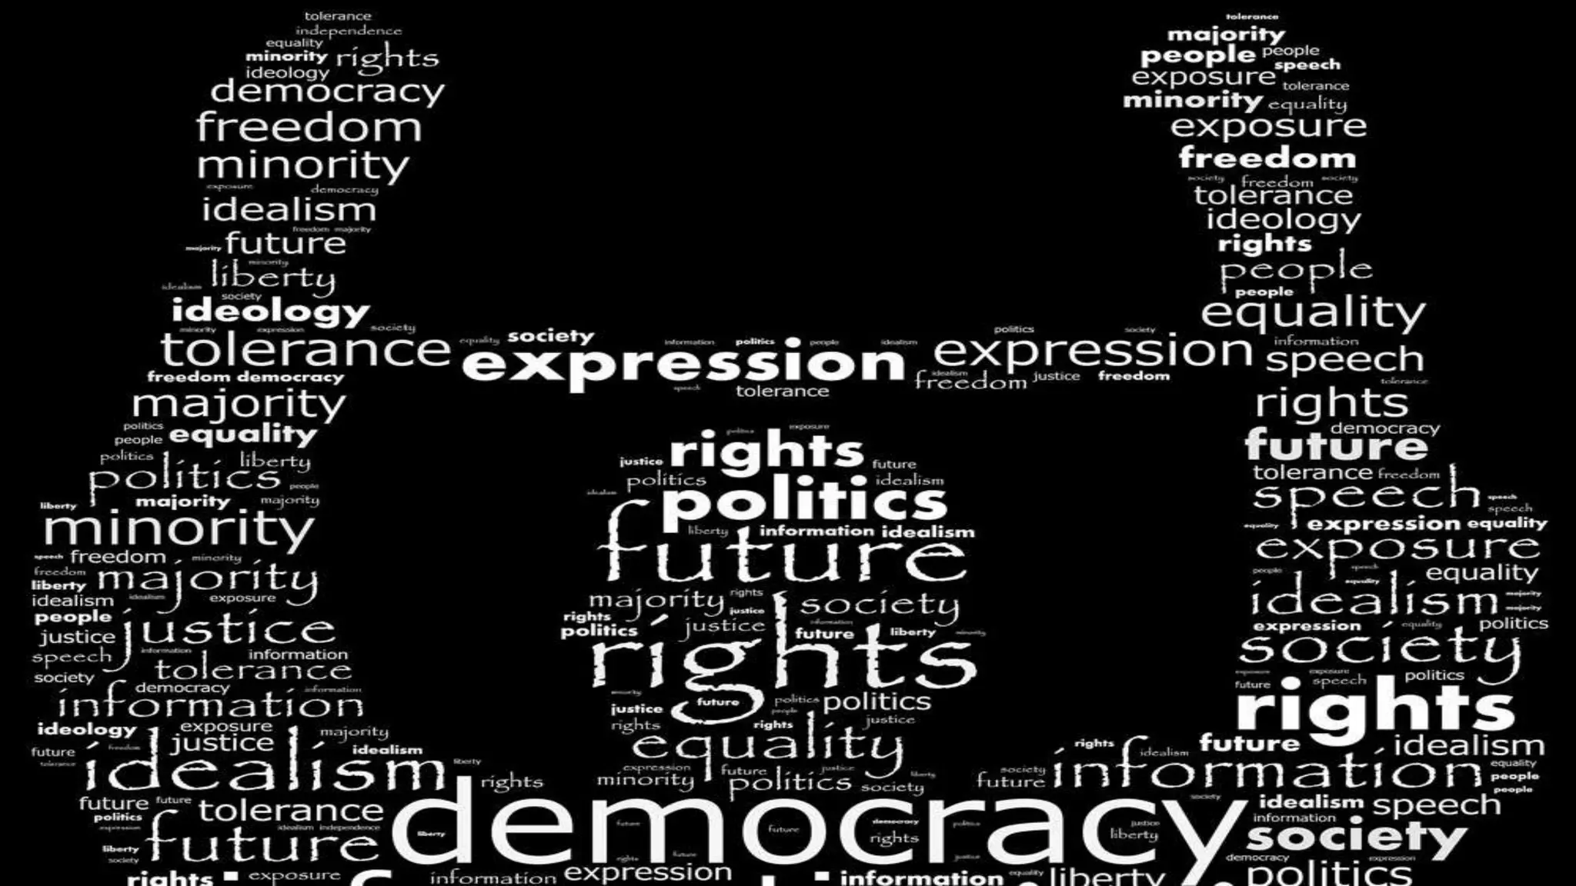
THE GOVERNMENT
OF THE PEOPLE,BY THE PEOPLE/Karunambigai/Social/SNS ACADEMY

Slide 6
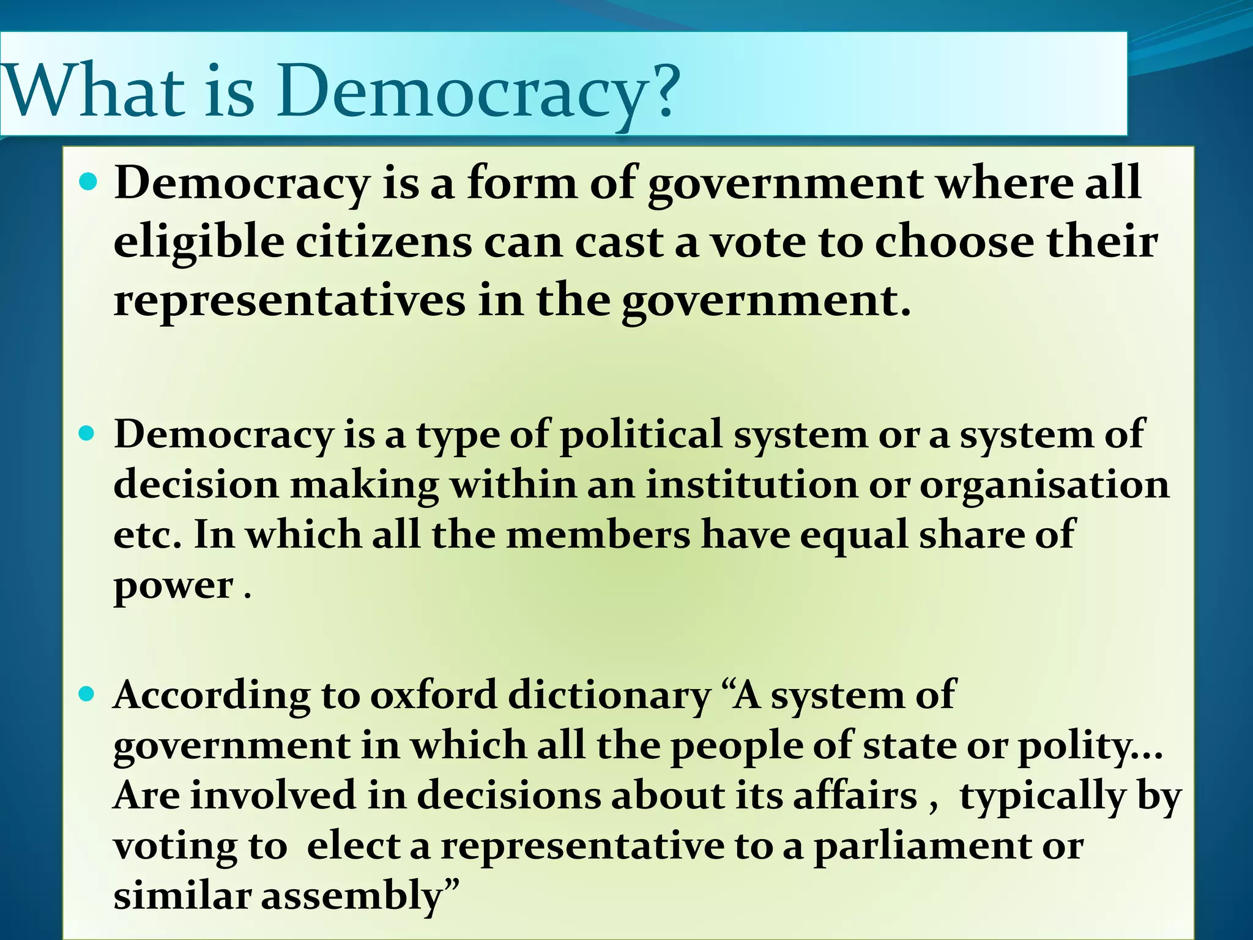
OF THE PEOPLE,BY THE PEOPLE/Karunambigai/Social/SNS ACADEMY

Slide 7
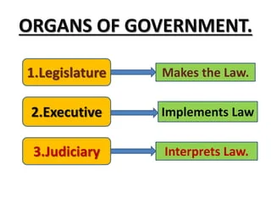
GOVERNMENT AND ITS FUNCTIONS
OF THE PEOPLE,BY THE PEOPLE/Karunambigai/Social/SNS ACADEMY

Slide 8
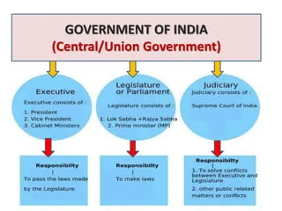

Slide 9
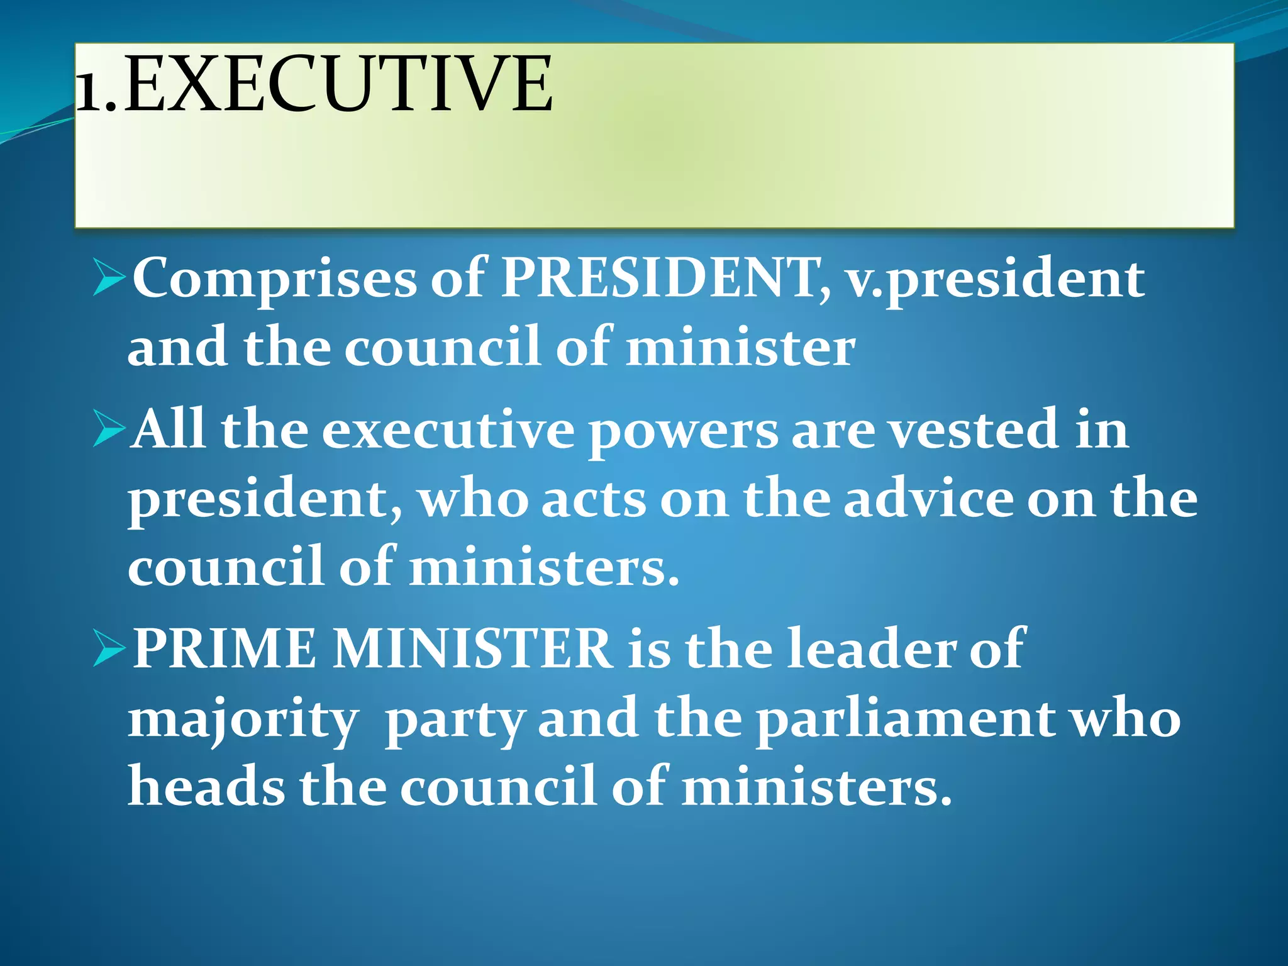
Major challenges of India and Pakistan
OF THE PEOPLE,BY THE PEOPLE/Karunambigai/Social/SNS ACADEMY

Slide 10
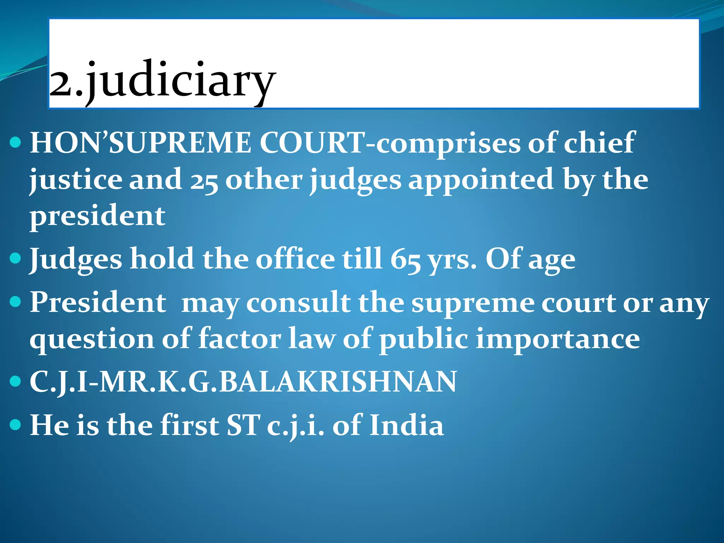
INDO-PAK WAR

Slide 11
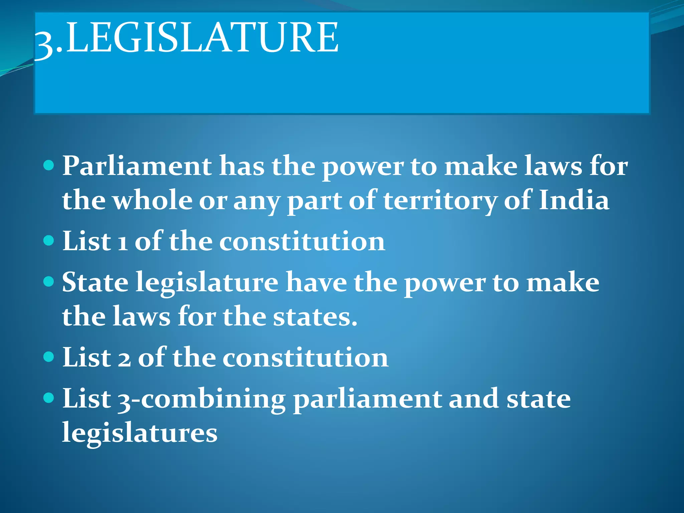
INDIA AND NEPAL

Slide 12
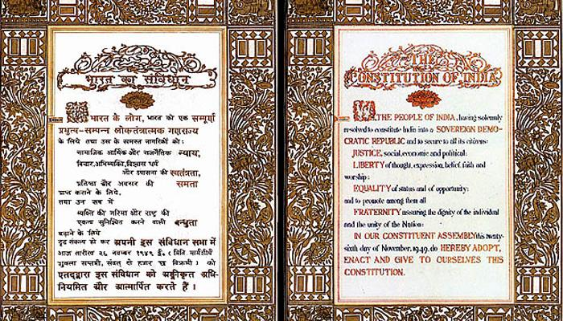
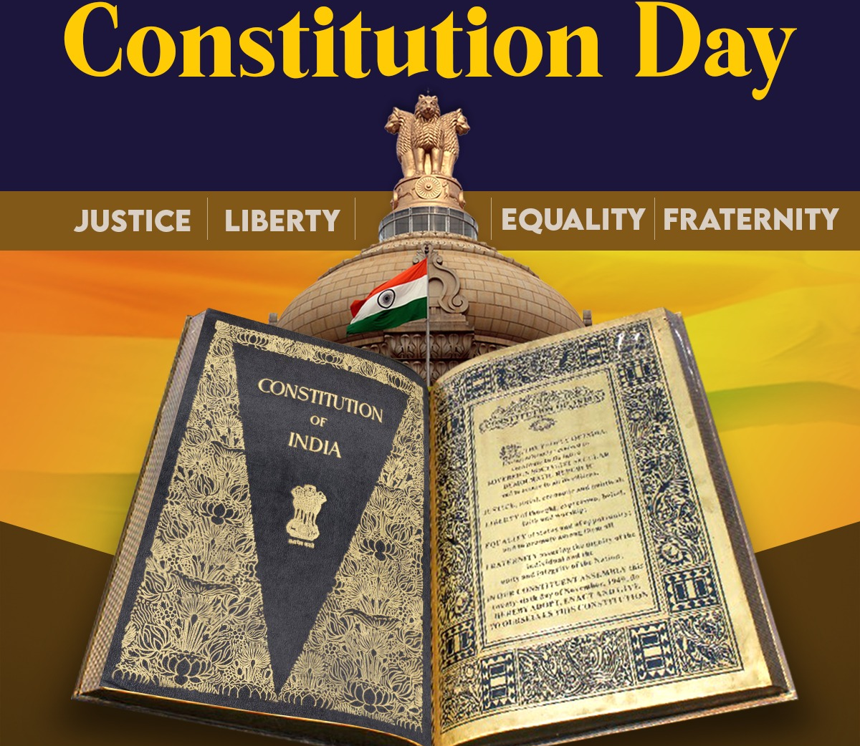
CONSTITUTION

Slide 13
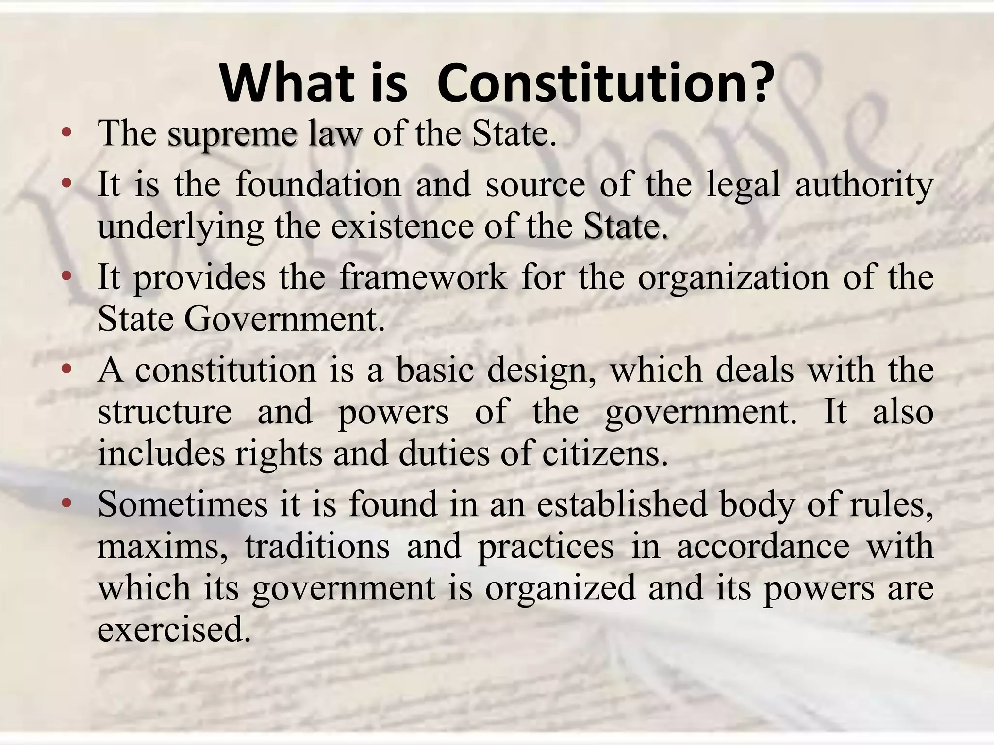
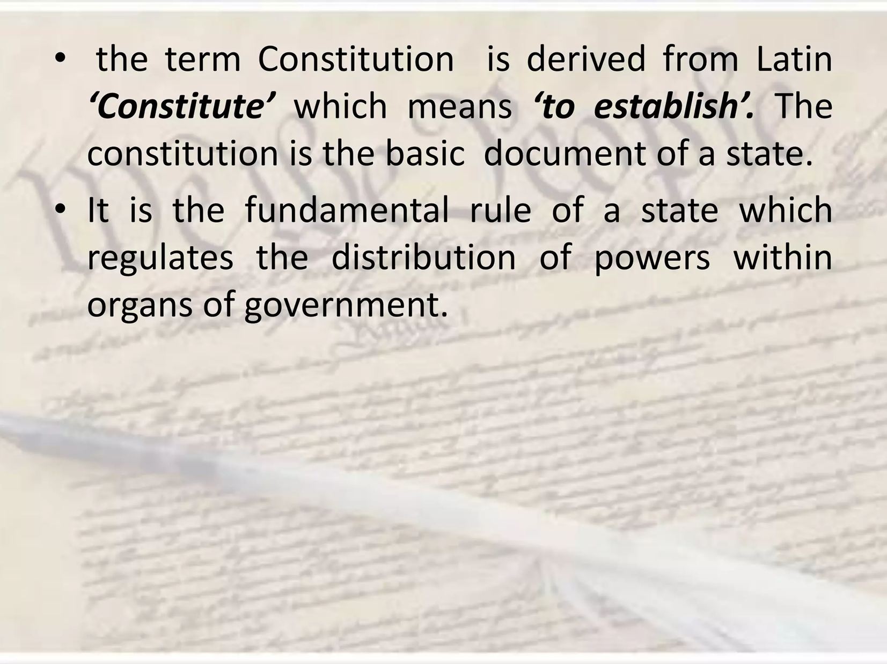
CONSTITUTION

Slide 14
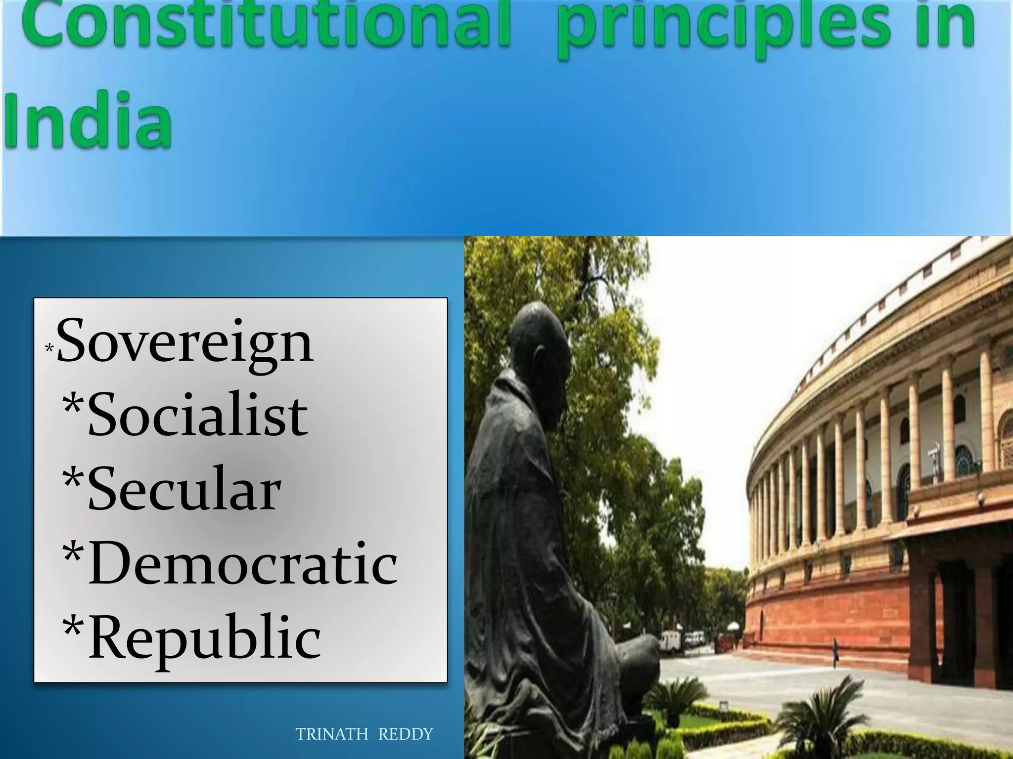
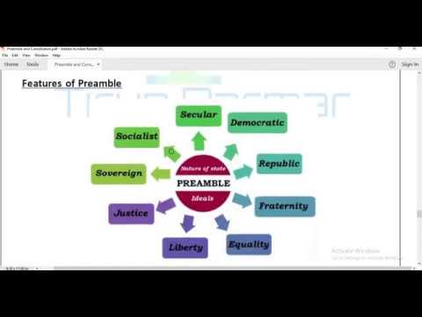

Slide 15
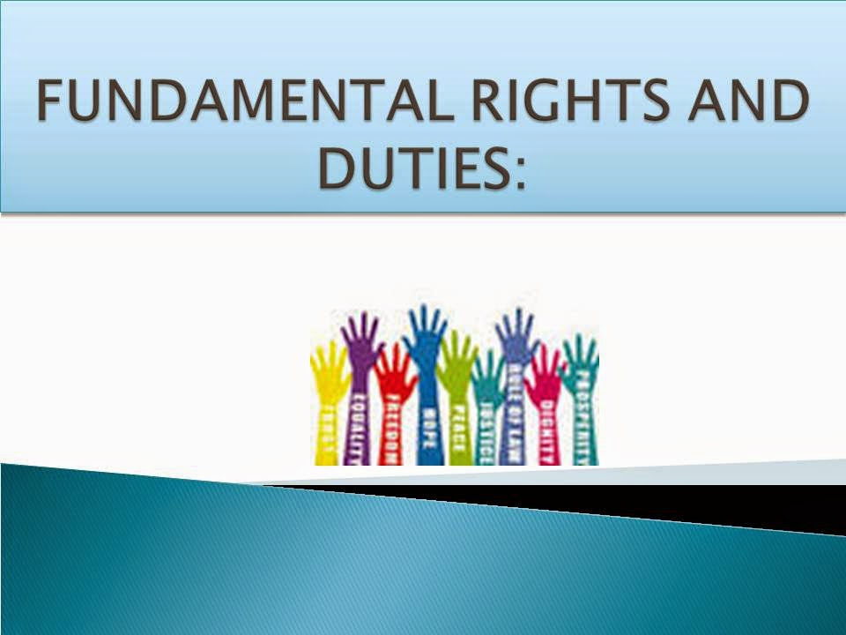
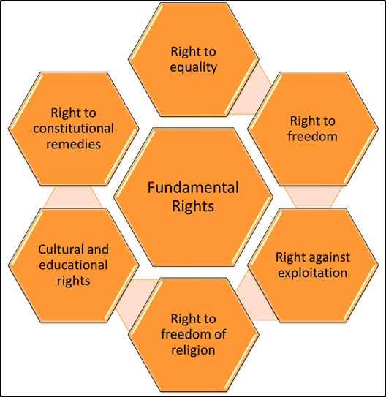
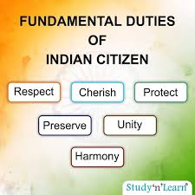

Slide 16
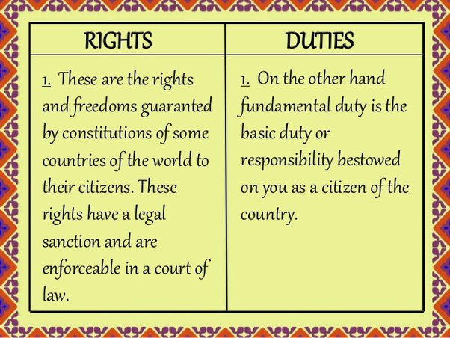
COMPARISON OF FUNDAMENTAL RIGHTS AND DUTIES

Slide 17
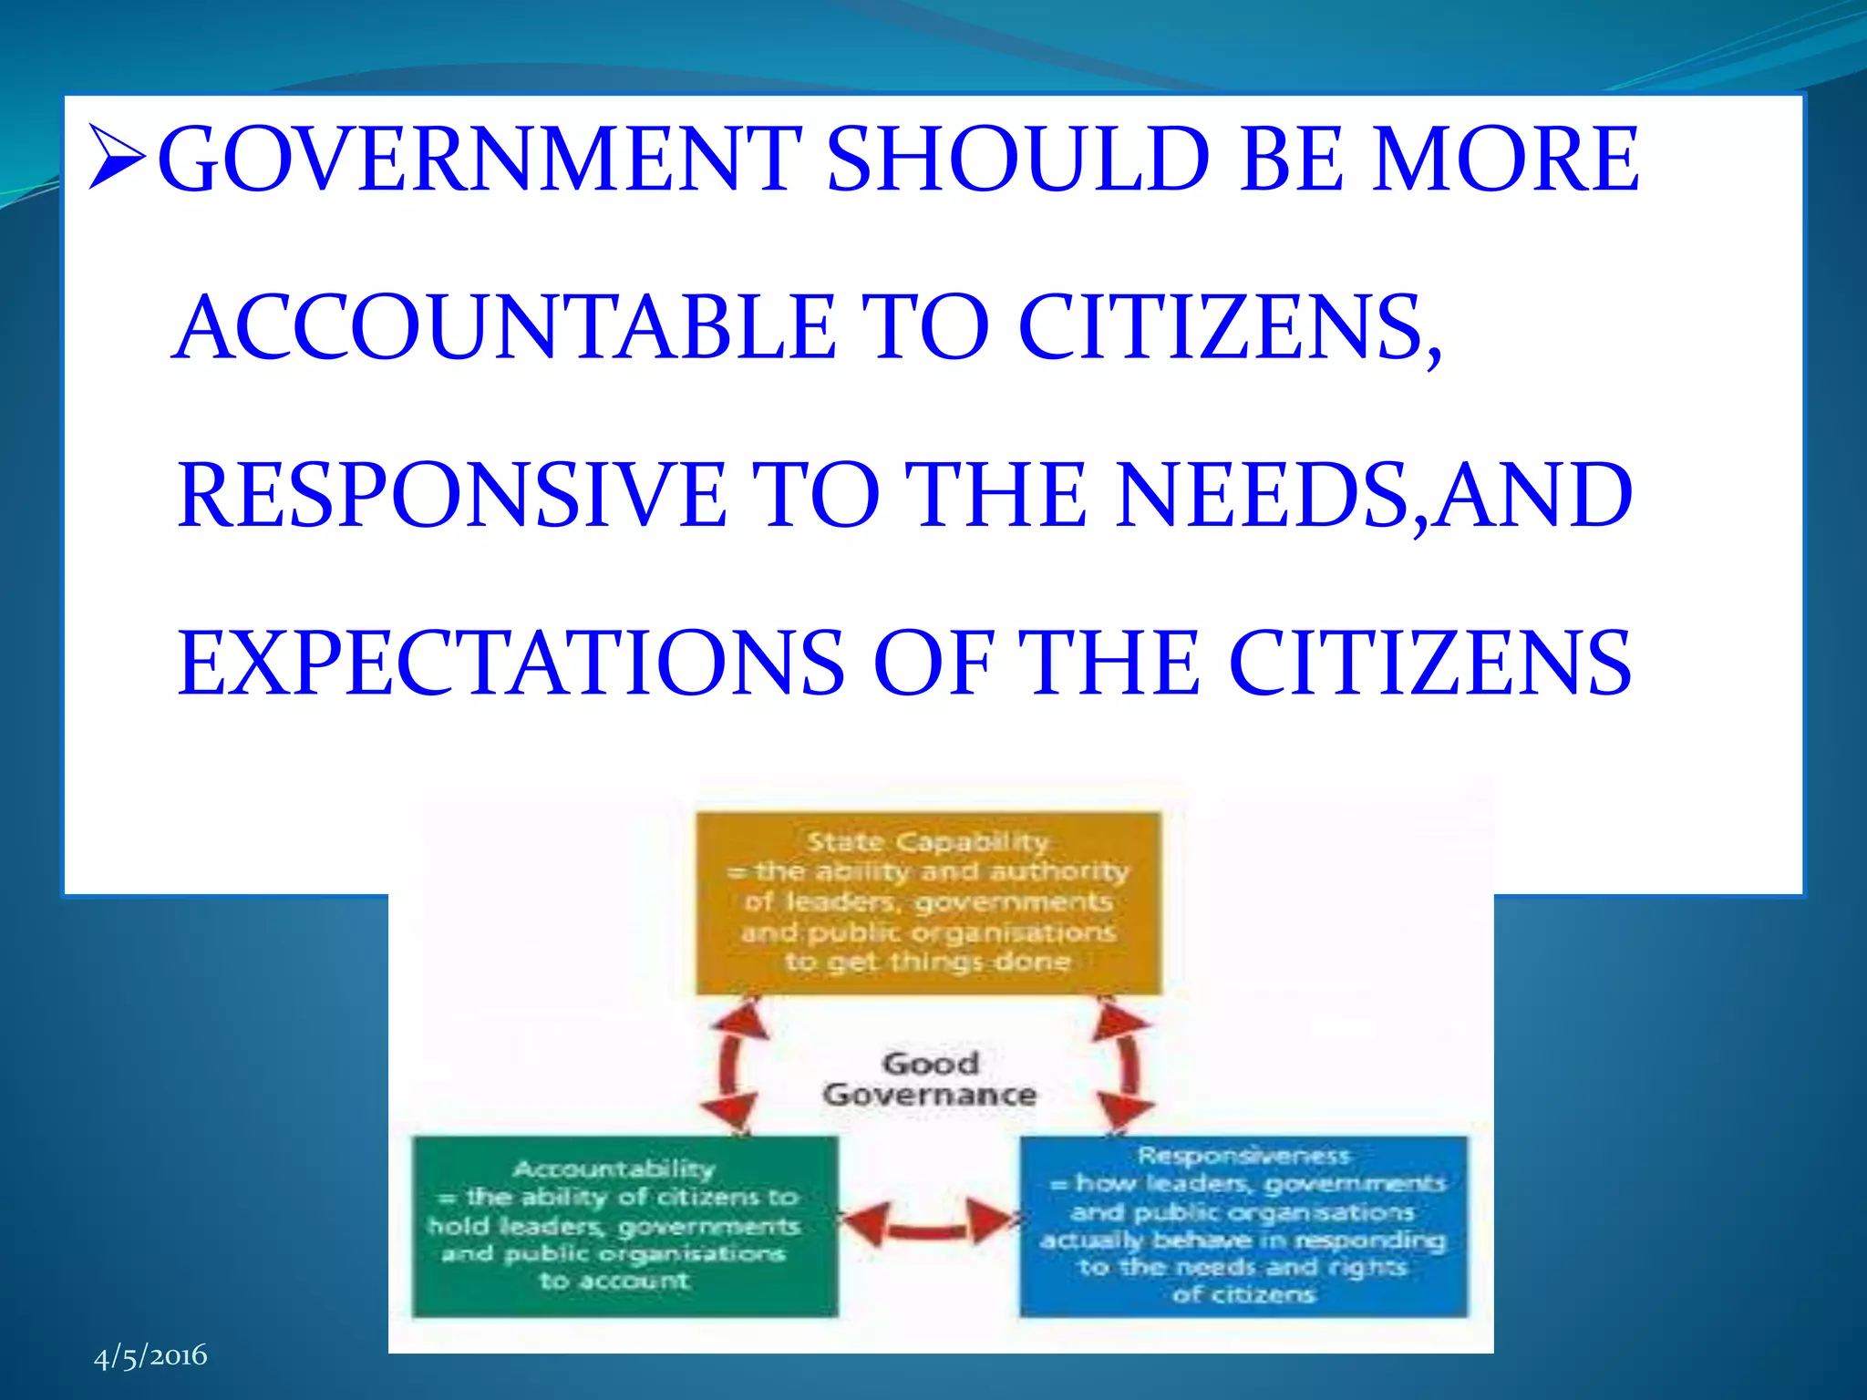

Slide 18
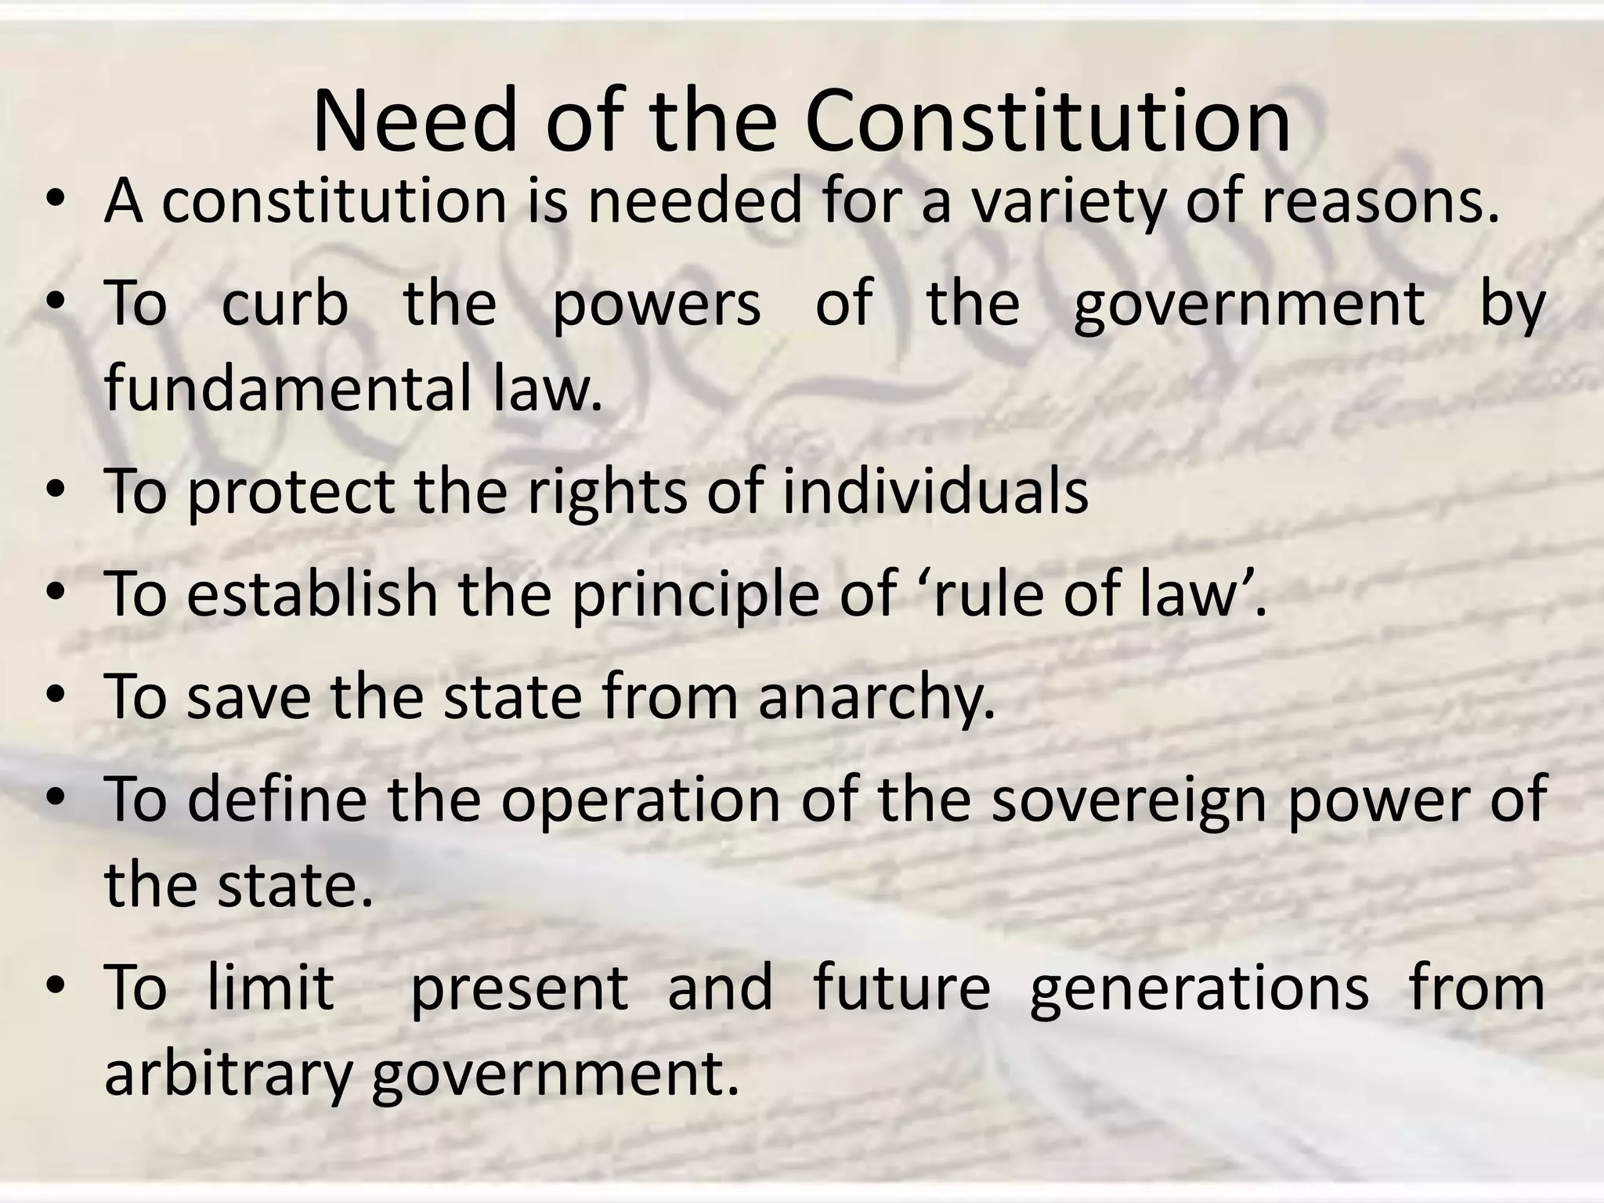

Slide 19
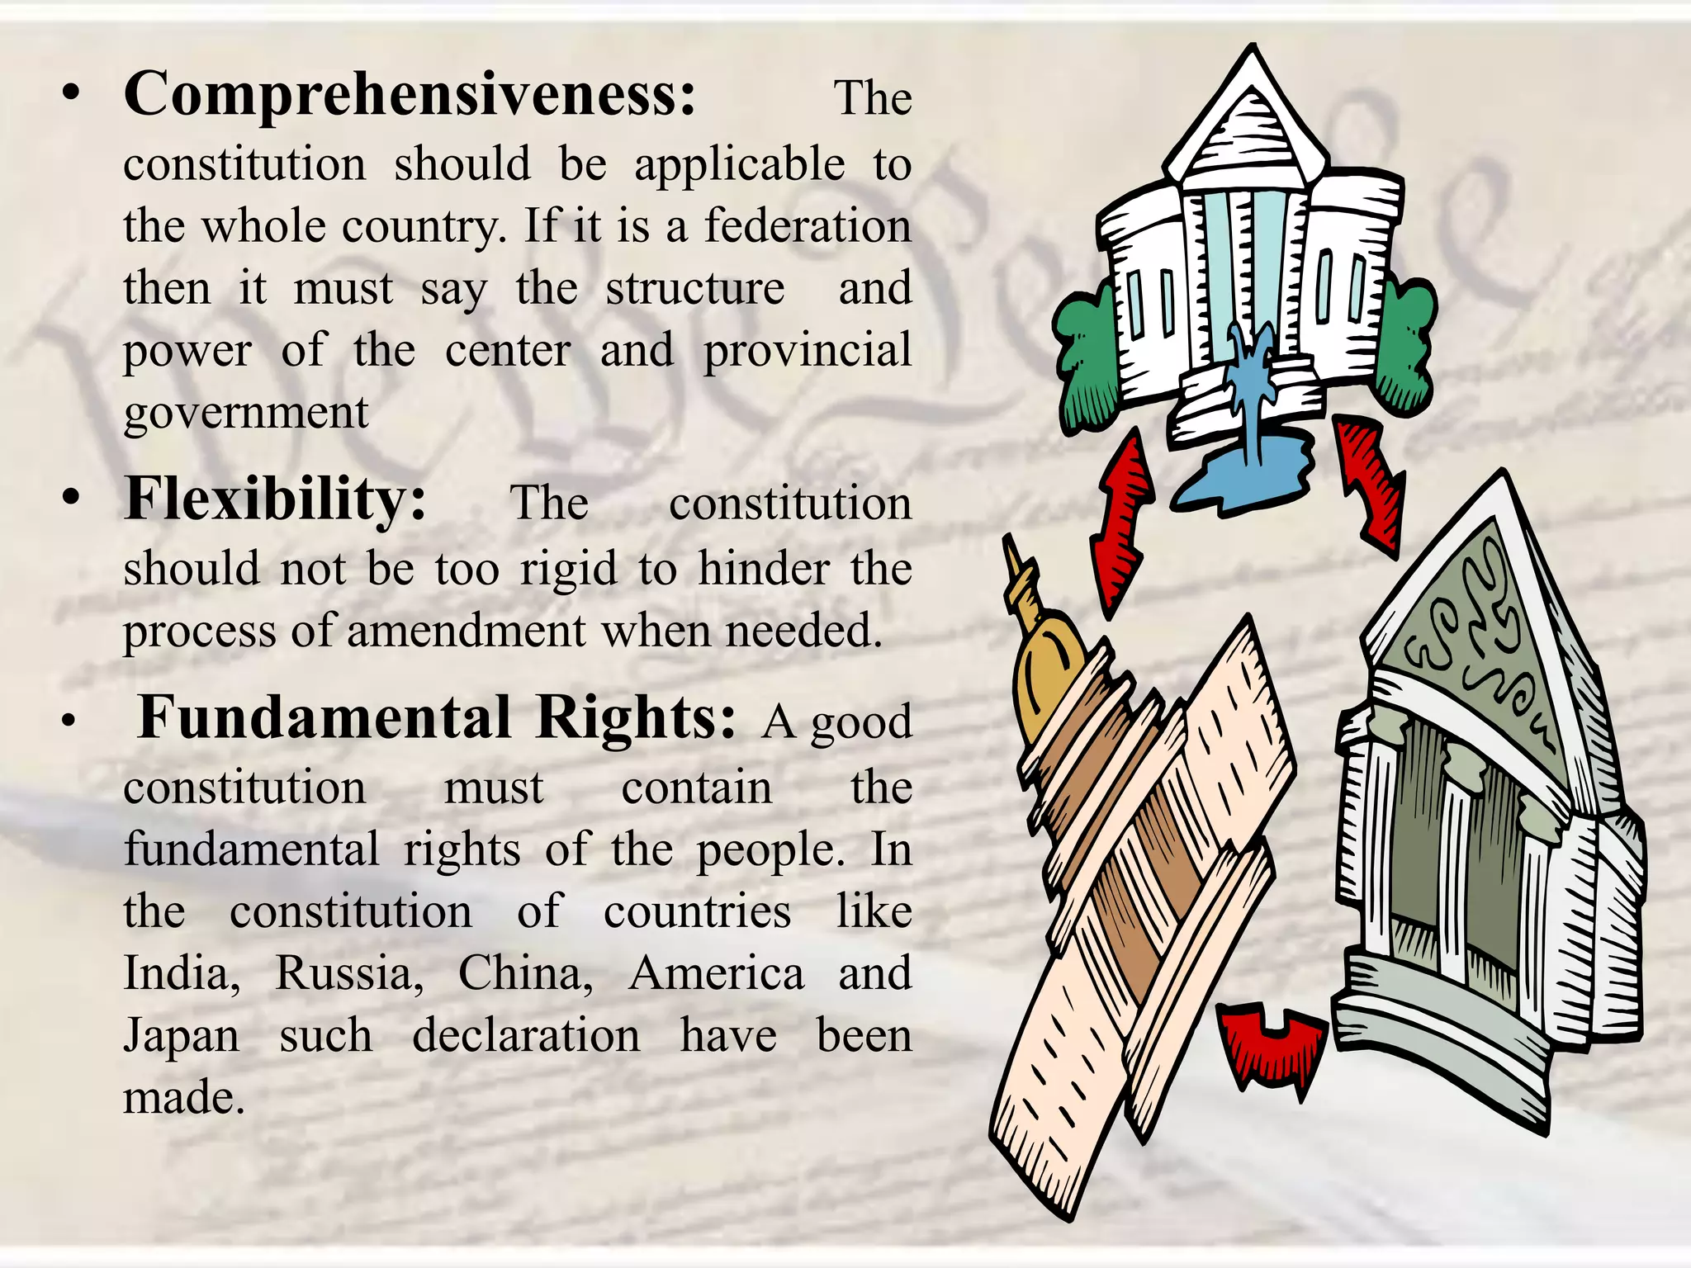

Slide 20


